Slide 1
2025
MEDUSA-X
Body Artist
- Application Portfolio -
JELANI SAMPLE
Email:
JelaniSample@yahoo.com
Phone/WhatsApp:
+1 (123) 456-6789
1

Slide 2
1
Artist Information
Field | Example
Full Name (Legal) | Jelani Sample
Professional Alias | JellSample Tattoo
Location / Country | Bogota, NJ
Experience | 4 years Tattoo & Piercing
Specialties (Define 1 or 2 maximun) | Fine Line • Color • Ear Curation
Languages | English
2

Slide 3
3
Artist Statement
“My goal is-----------------------------------------------------------------------------------------------------------------------------------------------------------------------------------------”
(Must be between in 150 to 200 characters)
3

Slide 4
OFFICIAL CERTIFICATE
License / Health Authority Registration
REMEMBER TO ADD PROOF OF OFFICIAL LICENSE
ALSO ADD AN EMAIL WITH YOUR FULL LEGAL NAME
You can request to verify, correct, or delete your personal data in accordance with the GDPR and the CCPA. Requests are verified and processed within legal timeframes. We will respect your request for deletion unless retention is legally required or justified if you are selected and wish to participate in Medusa-X.com. There will be no discrimination for exercising these rights. Only written requests sent to apply@medusa.com with the subject line "VERIFY, CORRECT, OR DELETE MY DATA" will be accepted.
4

Slide 5
2
Contact & Verification
Field | Example
Email (Verified) | Must match full legal name + use Gmail/Outlook/Yahoo domain
Government ID (Front + Back) | Upload PDF/JPG for identity check
License / Health Authority Registration | Mandatory for admission. Upload certificate or screenshot showing official registry number
Studio / Worksite Name | JellSample Ink Studio
Studio License (if applicable) | Upload local sanitary permit or inspection report
Payoneer Account | Required for future payments
5

Slide 6
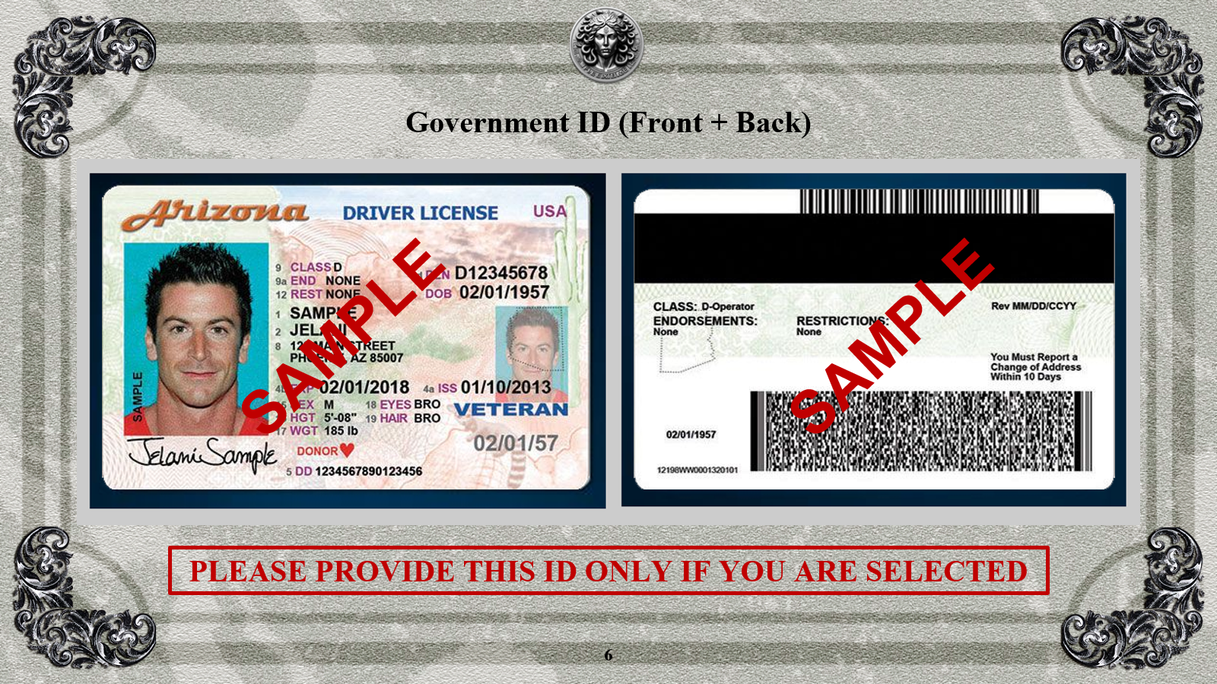

Slide 7
https://www.payoneer.com/
Options to Show Your Payoneer Account Without Exposing Sensitive Data
Partial Screenshot of the Main Dashboard
Take a screenshot of your Payoneer dashboard showing your name and the Payoneer logo.
Make sure to hide (by editing or cropping) any information such as balance, account number, transactions, or email.
Welcome or Confirmation Email
Find the email Payoneer sent you when you created your account or verified your identity.
You can display only the header of the email (with your name and the Payoneer logo), hiding the rest.
PLEASE PROVIDE THIS ONLY IF YOU ARE SELECTED
7

Slide 8
4
Portfolio Showcase
( Minimum 5 Images )
8

Slide 9
# | Category | Description | Image
1 | Tattoo – Fine Line Floral | Minimalist forearm floral design | 📸 Image 1
YOU CAN ADD ONE OR MORE IMAGES ABOUT SAME WORK IN IS THIS SLIDE
9

Slide 10
# | Category | Description | Image
2 | Tattoo – Realism Portrait | B/W portrait – shading control | 📸 Image 2
YOU CAN ADD ONE OR MORE IMAGES ABOUT SAME WORK IN IS THIS SLIDE
10

Slide 11
# | Category | Description | Image
3 | Piercing – Helix Pair | Double helix with gold studs | 📸 Image 3
YOU CAN ADD ONE OR MORE IMAGES ABOUT SAME WORK IN IS THIS SLIDE
11

Slide 12
# | Category | Description | Image
4 | Tattoo – Geometric Chest Piece | Mandala balance composition | 📸 Image 4
YOU CAN ADD ONE OR MORE IMAGES ABOUT SAME WORK IN IS THIS SLIDE
12

Slide 13
# | Category | Description | Image
5 | Piercing – Septum Jewelry | Precision placement and aftercare result | 📸 Image 5
YOU CAN ADD ONE OR MORE IMAGES ABOUT SAME WORK IN IS THIS SLIDE
13

Slide 14
5
Health & Safety Practice
Uses sterile, disposable materials (nitrile gloves, face mask)
Complies with local biosafety laws and Clean Ink Protocol
Maintains autoclave records
14

Slide 15
6
Social Media Links Provide all existing professional accounts (personal or studio):
Platform | Username / Link
Instagram | @JellSamplefinettoo
TikTok | @JellSamplefinettoo.ink
Facebook / Meta | fb.com/JellSamplefinettoo
YouTube | youtube.com/@JellSamplefinettoo
Pinterest | pinterest.com/JellSamplefinettoo
Threads (Meta) | @JellSamplefinettoo
X (Twitter) | @JellSamplefinettoo
Reddit | u/JellSamplefinettoo
Website (optional) | https://JellSamplefinettoo.com
15

Slide 16
7
Declaration & Consent
I declare that all information and licenses are authentic.
I agree to the MEDUSA-X Trial Plan Terms and Responsible Use Policy.
I consent to data processing under GDPR and CCPA for verification purposes.
Submit to apply@medusa-x.com with this Slides as .pdf
Putting clearly your full name in the subject: Jelani Sample, APPLICATION
16

