Slide 1
MEDUSA-X | Body Artist
- Application Portfolio -
2025
Laura Patricia Walteros Vergara
Email:
LauraPatriciaWalterosVergara@hotmail.es
Phone/WhatsApp:
+57 (123) 456-6789

Slide 2
1
Artist Information
Field | Example
Full Name (Legal) | Laura PatriciaWalterosVergara
Professional Alias | Laura Tattoo
Location / Country | Bogotá, Colombia
Experience | 4 years Tattoo & Piercing
Specialties (Define 1 or 2 maximun) | Fine Line • Color • Ear Curation
Languages | Spanish

Slide 3
2
Contact & Verification
Field | Example
Email (Verified) | Must match full legal name + use Gmail/Outlook/Yahoo domain
Government ID (Front + Back) | Upload PDF/JPG for identity check
License / Health Authority Registration | Mandatory for admission. Upload certificate or screenshot showing official registry number
Studio / Worksite Name | Laura Ink Studio
Studio License (if applicable) | Upload local sanitary permit or inspection report
Payoneer Account | Required for future payments

Slide 4
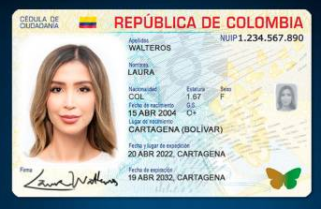
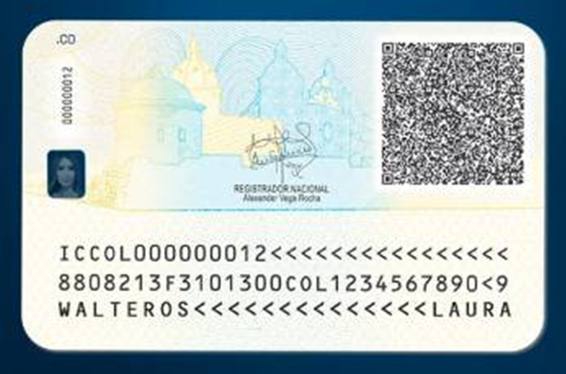


Government ID (Front + Back)
Source: registraduria.gov.co
Only for illustrative purposes
Source: registraduria.gov.co
Only for illustrative purposes

Slide 5
OFFICIAL CERTIFICATE
License / Health Authority Registration

Slide 6
https://www.payoneer.com/es/

Slide 7
“My goal is-----------------------------------------------------------------------------------------------------------------------------------------------------------------------------------------”
3
Artist Statement
(Must be between in 150 to 200 characters)

Slide 8
Portfolio Showcase
( Minimum 5 Images )
4

Slide 9
# | Category | Description | Image
1 | Tattoo – Fine Line Floral | Minimalist forearm floral design | 📸 Image 1

Slide 10
# | Category | Description | Image
2 | Tattoo – Realism Portrait | B/W portrait – shading control | 📸 Image 2

Slide 11
# | Category | Description | Image
3 | Piercing – Helix Pair | Double helix with gold studs | 📸 Image 3

Slide 12
# | Category | Description | Image
4 | Tattoo – Geometric Chest Piece | Mandala balance composition | 📸 Image 4

Slide 13
# | Category | Description | Image
5 | Piercing – Septum Jewelry | Precision placement and aftercare result | 📸 Image 5

Slide 14
Health & Safety Practice
Uses sterile, disposable materials (nitrile gloves, face mask)
Complies with local biosafety laws and MEDUSA-X Clean Ink Protocol
Maintains autoclave records and Complies first-aid training

Slide 15
6
Social Media Links (required under § W)
Provide all existing professional accounts (personal or studio):
Platform | Username / Link
Instagram | @laurafinettoo
TikTok | @laurafinettoo.ink
Facebook / Meta | fb.com/laurafinettoo
YouTube | youtube.com/@laurafinettoo
Pinterest | pinterest.com/laurafinettoo
Threads (Meta) | @laurafinettoo
X (Twitter) | @laurafinettoo
Reddit | u/laurafinettoo
Website (optional) | https://laurafinettoo.com

Slide 16
7
Declaration & Consent
I declare that all information and licenses are authentic.
I agree to the MEDUSA-X Trial Plan Terms and Responsible Use Policy.
I consent to data processing under GDPR and CCPA for verification purposes.
Submit to apply@medusa-x.com or via platform upload form.

Slide 17
Submission Requirement: Slide Format Warning
To ensure compatibility and visual integrity, all PowerPoint slides must be saved and submitted as high-resolution images.
Applications will not be accepted unless this requirement is met.
What You Must Do:
Convert each slide in your presentation to an image format (e.g., PNG or JPEG).
Ensure images are high resolution (minimum 300 DPI recommended).
Submit the image files obtained from your cellphone in the order of your slides.
Do Not:
Submit the original PPT or PPTX file.
Include low-resolution or compressed images.
Use screenshots or photos of your screen.
This step is mandatory to preserve layout, fonts, and embedded visuals across systems. If you're unsure how to convert your slides properly, I can walk you through it.

Slide 18
You can easily convert until 20 images into a single PDF using several methods depending on your operating system and preferences.
Here's a breakdown:
Windows (Built-in Method) Select all 20 images in File Explorer.
Right-click → choose Print. In the Printer dropdown, select Microsoft Print to PDF. Choose Full page photo or another layout. Click Print → choose a filename → Save.
Mac (Preview App)
Select all images → Right-click → Open With > Preview. In Preview, drag to reorder if needed. Go to File > Print → click PDF > Save as PDF.
Online Tools (Free & Easy)
iLovePDF
Smallpdf
PDFCandy
Just upload your images, arrange them, and download the PDF.

